Slide 1
Web Scraping project
Erasmus, Alex, Joseph

Slide 2
Our Goal
11 stocks that are classified within the financial sector within Hang Sang Index
Identifying stocks that are ideal for pairs trading
Identifying one pair of stocks that has the most trading opportunities

Slide 3

Hang Seng Index (HSI)
Hang Seng Index (HSI) is a free-float market capitalization-weighted index of the sixty largest companies that trade on the Hong Kong Exchange
It is widely considered as the benchmark equity market index in Hong Kong

Slide 4

What is pairs trading?
Benefit from virtually any market conditions
Use of statistical and technical analysis
Strategy involves matching of long and short position of two stocks within the same sector
High positive correlation historically greater or equal to 0.8
Trader identifies correlation discrepancy
The two stocks deviate from their historical correlation in the short-term

Slide 5

Aim and Business Values
Aim of this project
Identifying one pair of stocks to perform pairs trading
Higher volatility means higher profits potentially
High liquidity/high trading volume
Easier to trade
How to Profit?
When The two stocks deviate from their historical trending correlation in the short-term
Stock that is underperforming will rise in value
Overperforming stocks will lose value overtime
Taking long position in underperforming stock
Taking a short position on outperforming
Profit is made by closing these two positions when correlation resume normal

Slide 6
How are we going to do that?
Data collection through web scraping
Data Processing
Data Visualization

Slide 7

Data Collection
Web-scraping
BeautifulSoup
Selenium
API

Slide 8
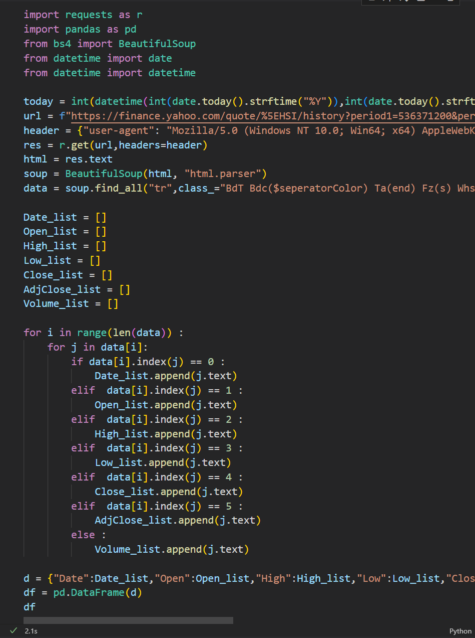
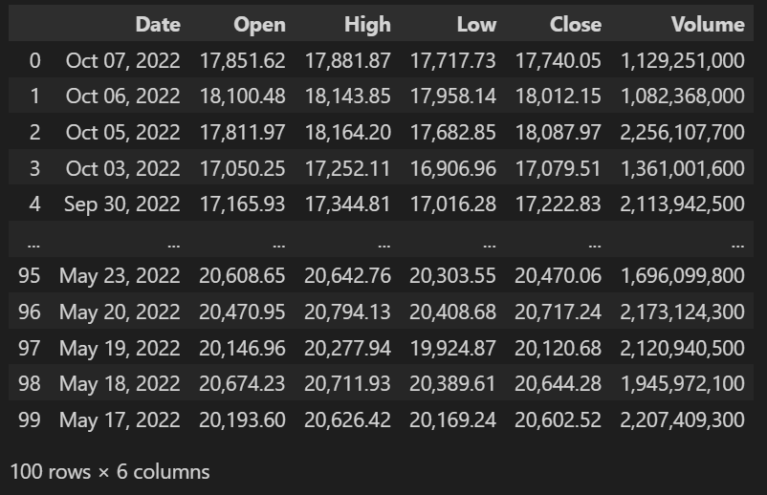
Web-scraping
BeautifulSoup

Slide 9
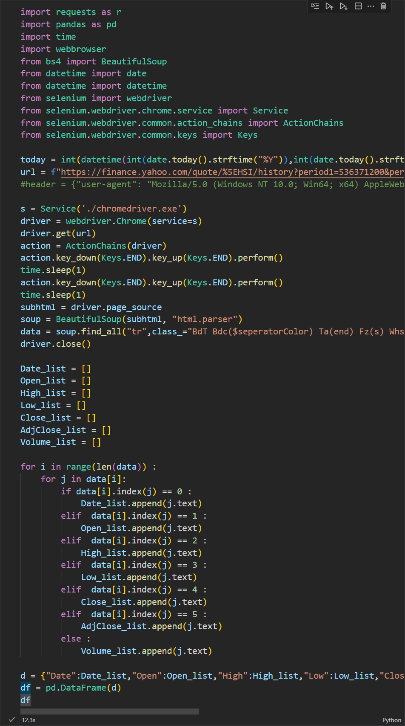
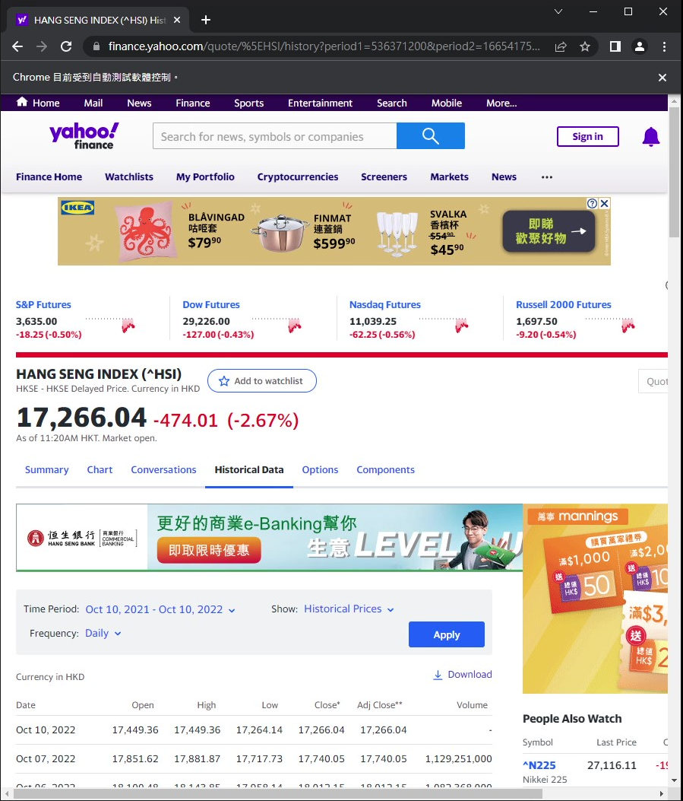
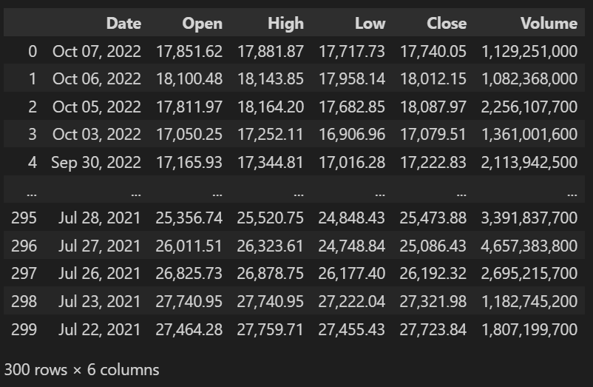
Web-scraping -
BeautifulSoup & Selenium

Slide 10
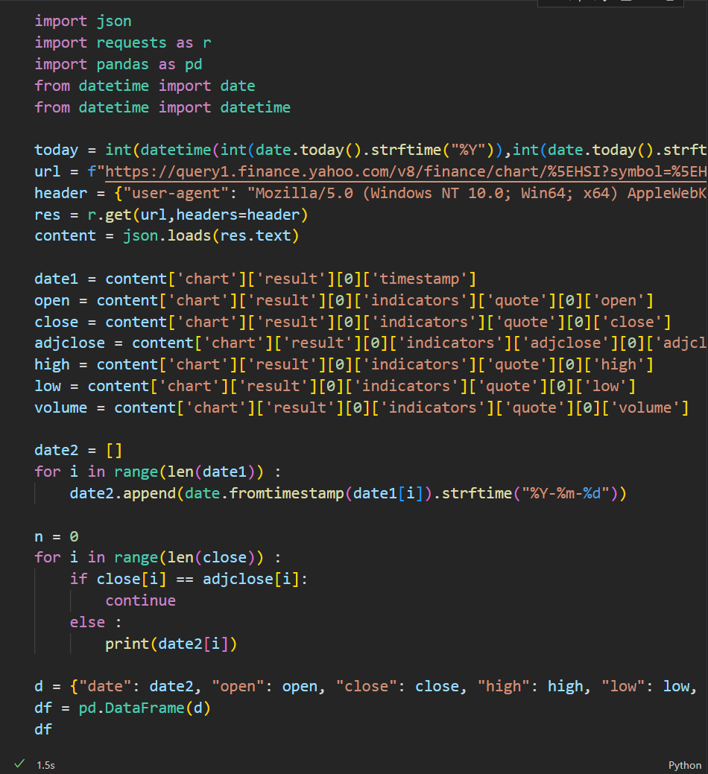
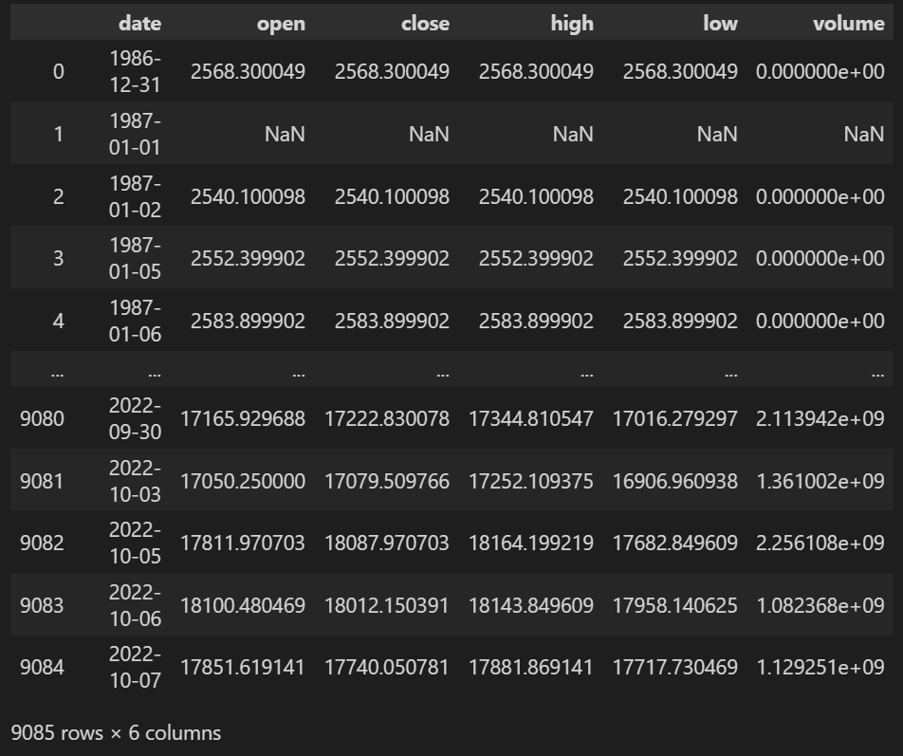
API

Slide 11
Web-scraping vs APIs
 | Web-scraping BeautifulSoup | Web-scraping BeautifulSoup & Selenium | API
Quantity of Library used | 5 | 9 | 5
Time | 2.1s | 12.3s | 1.5s
Quantity of returned results (rows) | 100 | 300 | 9085
Conclusion | Due to the design of the website, we were unable to obtain the full set of data | Able to obtain the necessary data, but very inefficient way with use of many libraries | Most efficient way but must bear in mind that not all websites support the use of API

Slide 12
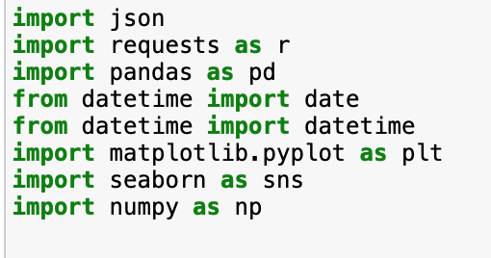
Libraries Used
Import the relevant libraries to help:
Storing and extracting our data
Arrays computing
Making requests to our URL
Data manipulation & analysis
Manipulating dates and time
Plotting and drawing informative statistical graphics

Slide 13

Data Collection
“https://query1.finance.yahoo.com/v8/finance/chart/{url_list[i]}?symbol={url_list[i]}&period1={day_b10}&period2={today}&useYfid=true&interval=1d&includePrePost=true&events=div%7Csplit%7Cearn&lang=en-US&region=US&crumb=c0iNuYsQEnn&corsDomain=finance.yahoo.com"
This is the URL for our API source
Prepared the source of API by:
Setting the tickers of the stocks
Setting the period

Slide 14

Data Collection
Send out request to the server
Read the data as JSON file
From URL – Yahoo finance
Base on the period and tickers set

Slide 15

Data Preprocessing

Slide 16
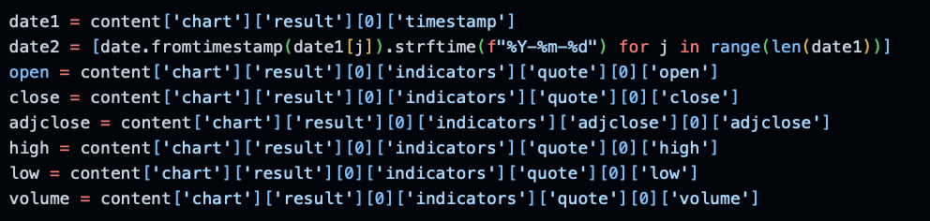
Data Preprocessing
Reading the data:
“date1” was read as raw data
“date2” decoded day time structure to date format
Past 10 years till the present day

Slide 17

Data Preprocessing
Using dataset to:
Convert to Pandas data frame
“df = pd.DataFrame”
For implementing insight analysis from Metplotlib and Seaborn

Slide 18
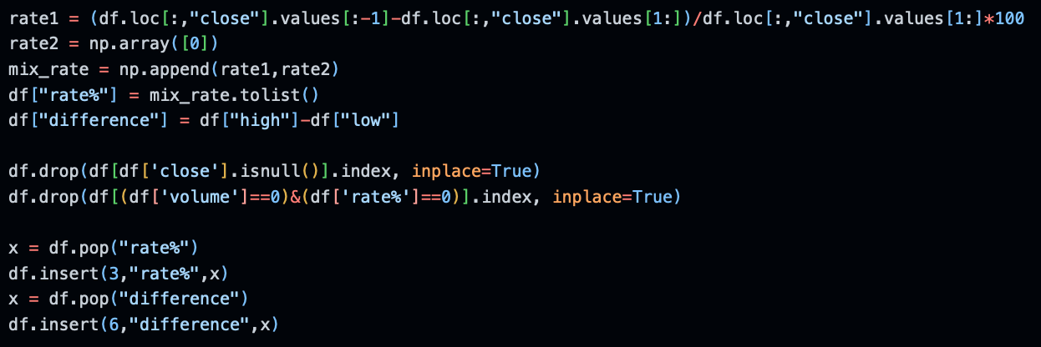
Data Preprocessing
Additional calculations with our dataset:
“rate1” & “rate2” new array
New variable “rate%” & “difference”
Differences of closing prices between each day
Figures for further analysis
Cleaning our dataframe:
”df.drop”
Rows when no closing price/trading volume
”dp.pop” & ”df.insert”
Move the column to a more desirable position

Slide 19
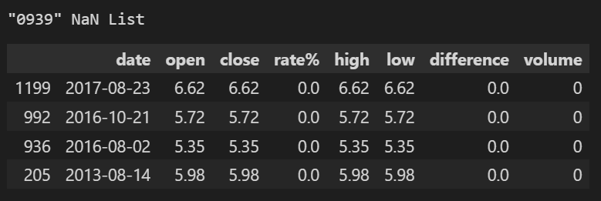
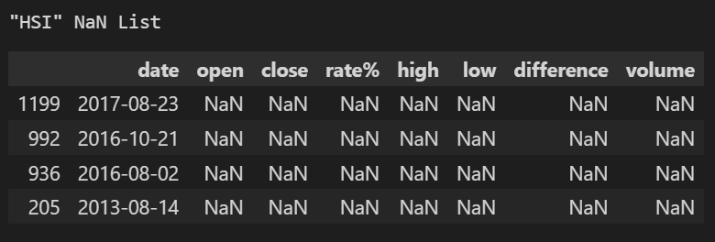
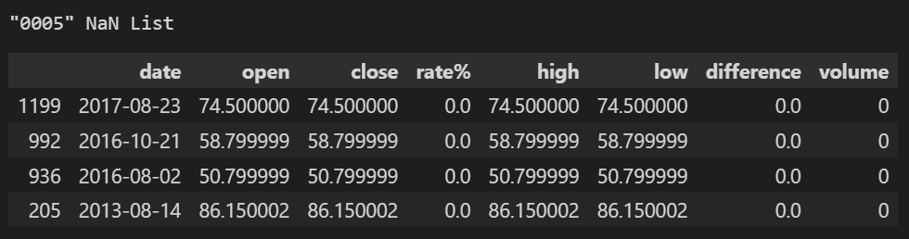
Data Preprocessing
This is the rows where:
We have manipulated using ”df.drop”
Rows when no closing price/trading volume have been removed

Slide 20
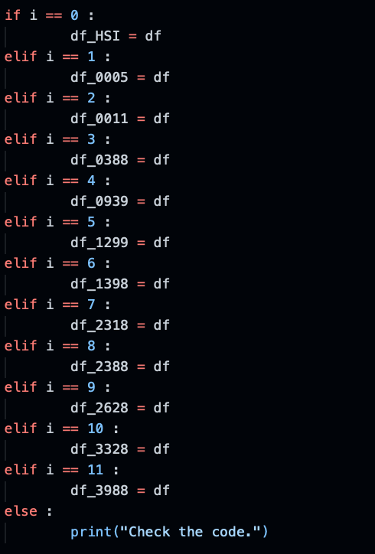
Final Data Frame
Assign each stock to a variable
Print out data frame according to user’s input

Slide 21
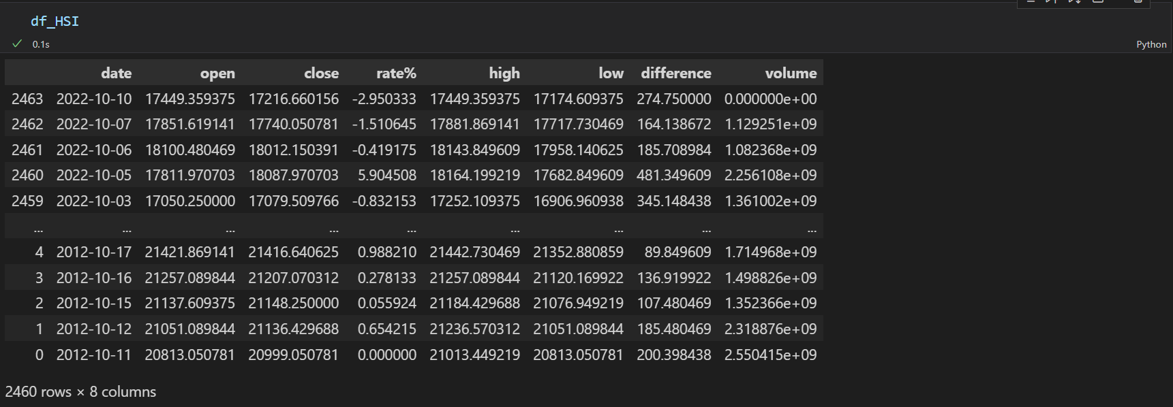
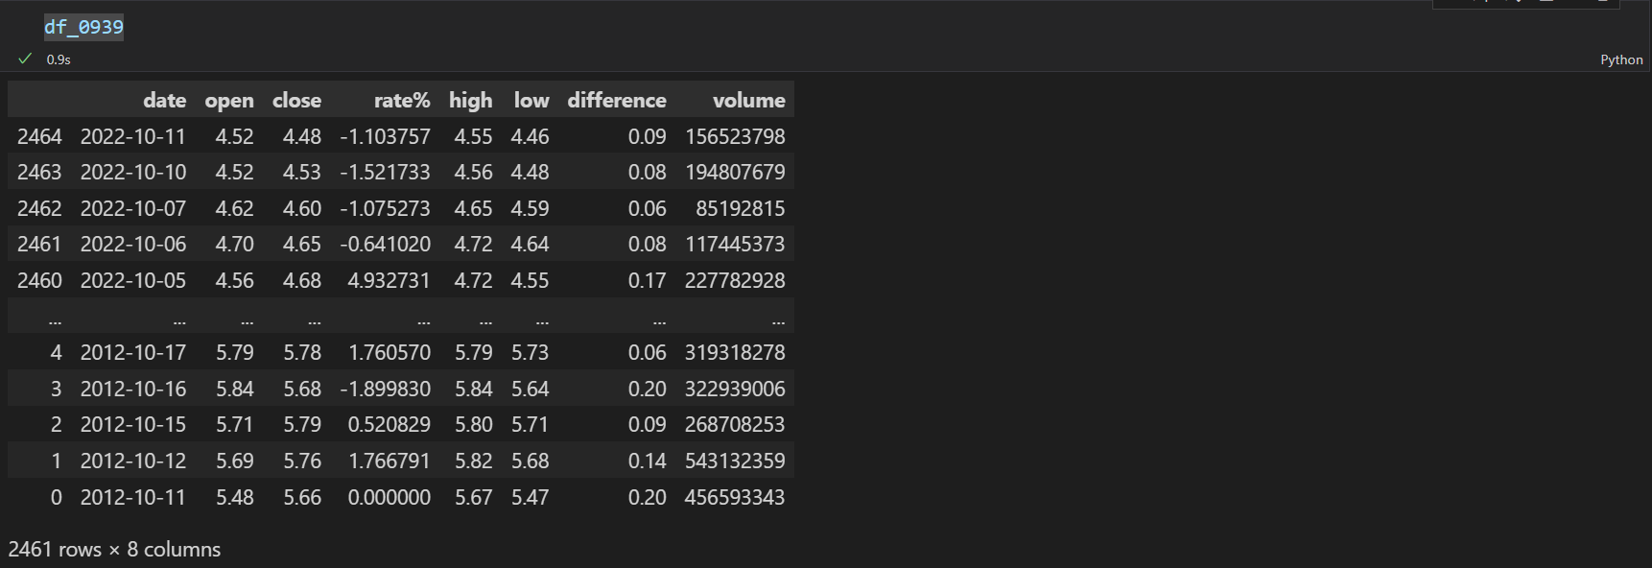
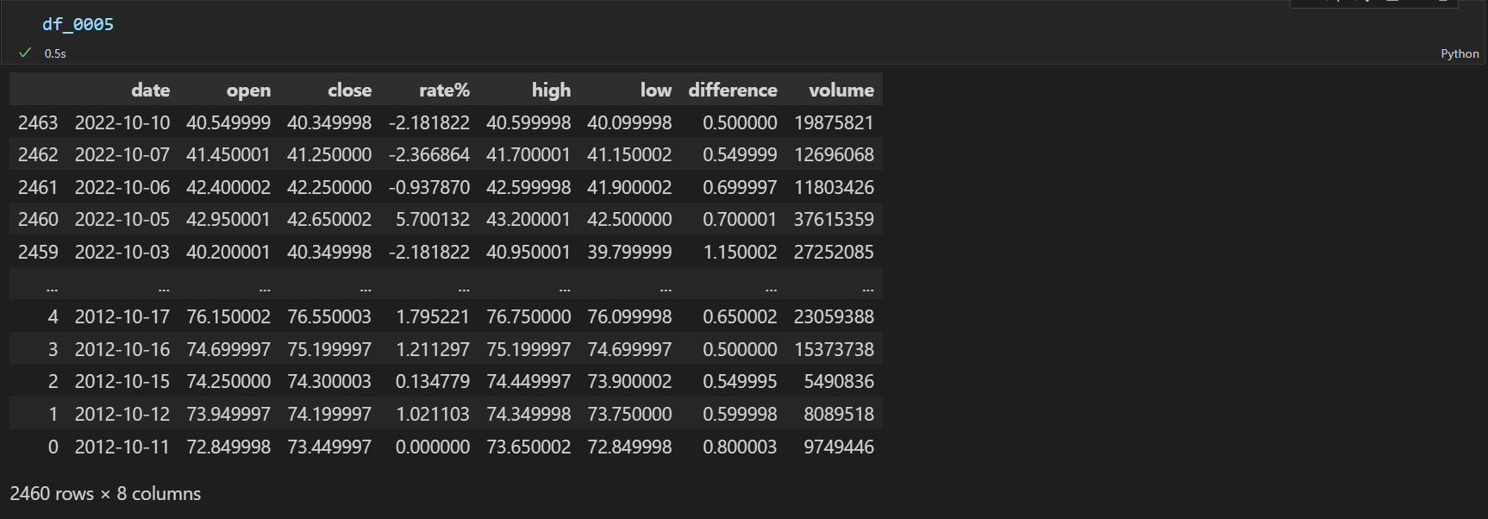
Final Data Frame Output
Upon running the for loop:
Data frame is outputted
With rows of ‘nan’ and ‘nil’ values removed
User may now use the data frame for further manipulation

Slide 22
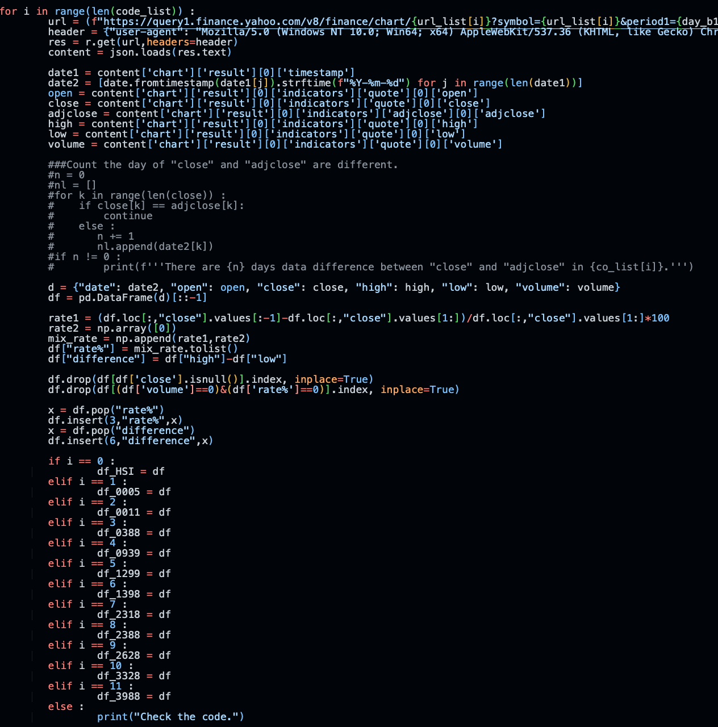
Final Data Frame
For loop is used
Ensure the the codes are iterated over the whole sequence

Slide 23
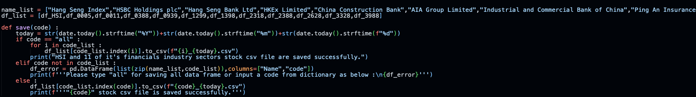
Function For downloading CSV File
Exporting as csv files:
Users’ choice of stocks
Using ‘code’ / ‘all’
CSV files for future manipulation

Slide 24


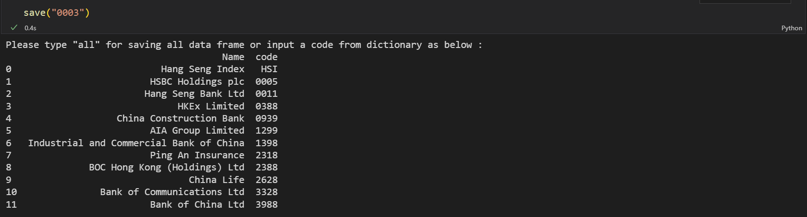
Function For downloading CSV File
User have a choice to:
Save all 12 data frame as CSV
Save a particular data frame as CSV
If input is is not within the 12 data frame:
Output will return the full list
Exporting as csv files:
Users’ choice of stocks
Using ‘code’ / ‘all’
CSV files for future manipulation

Slide 25
Quick Recap
Upon collecting our data using an API:
Obtained data of 10 years relating to users’ input
Created a pandas data frame
Perform additional calculations with our data
Cleaned up our data for easier understanding
Saving the data as CSV files for future manipulation

Slide 26

Data Visualization
Areas we have considered in the making of our content:
Easily understandable by users
Showcasing relevant information
The flow and color of our content

Slide 27
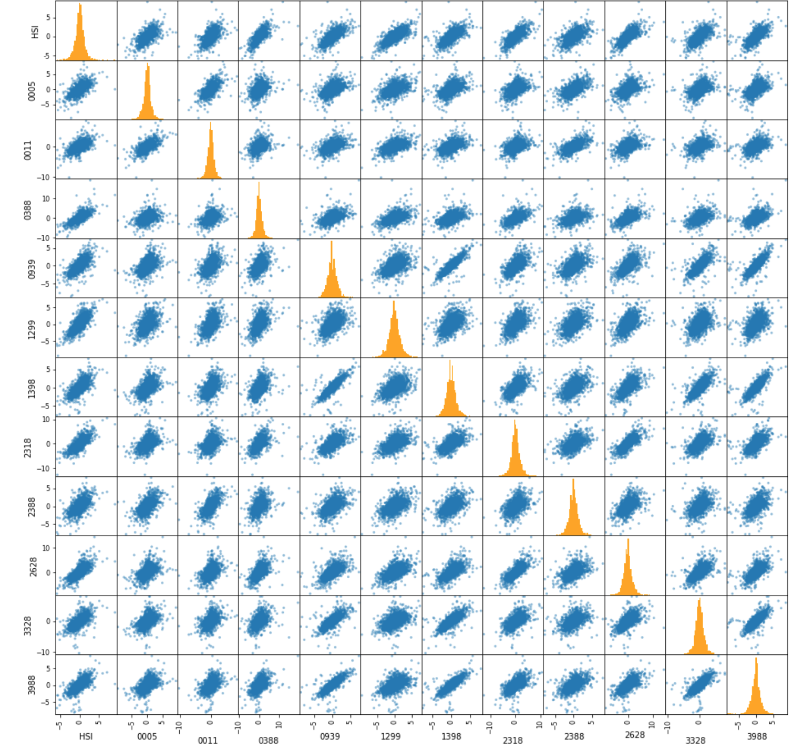
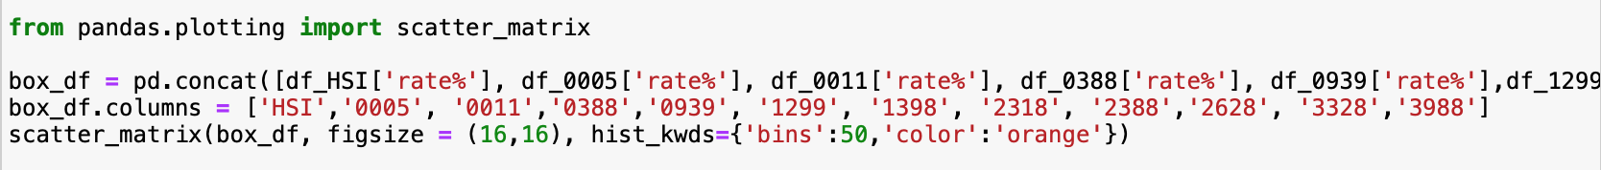
Scatter Plot – Correlation
Pandas framework allow us to work with scatter matrices easily
Using variable ‘rate%’ – percentage change in closing price
Showcasing correlation of the daily percentage return/change of stocks
Still quite difficult to read or spot out immediately which pair of stocks have high correlation historically (>0.8)

Slide 28
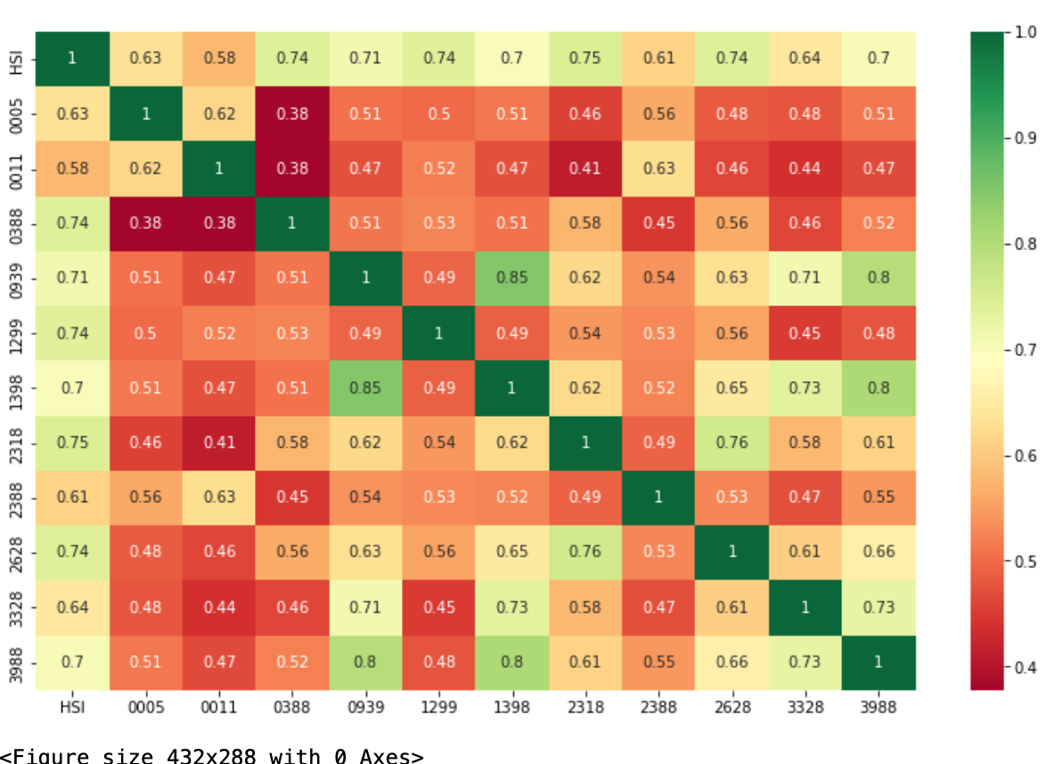
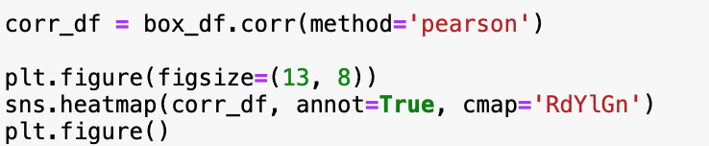
Heat Map - Correlation
Seaborn
Heatmap
Much easier to read, tidy and neat
(lower triangular area = upper triangular)
Presented in correlation figures in a matrix (the strength of their relationship)
Color scale indicates how correlated 2 stocks are
The pair 1398 and 0939 has the highest linear correlation
Followed by 0939 & 3988 and 1398 & 3988. Correlation is around 0.8
* We are only interested in pairs with correlation higher than 0.8 for this exercise.

Slide 29
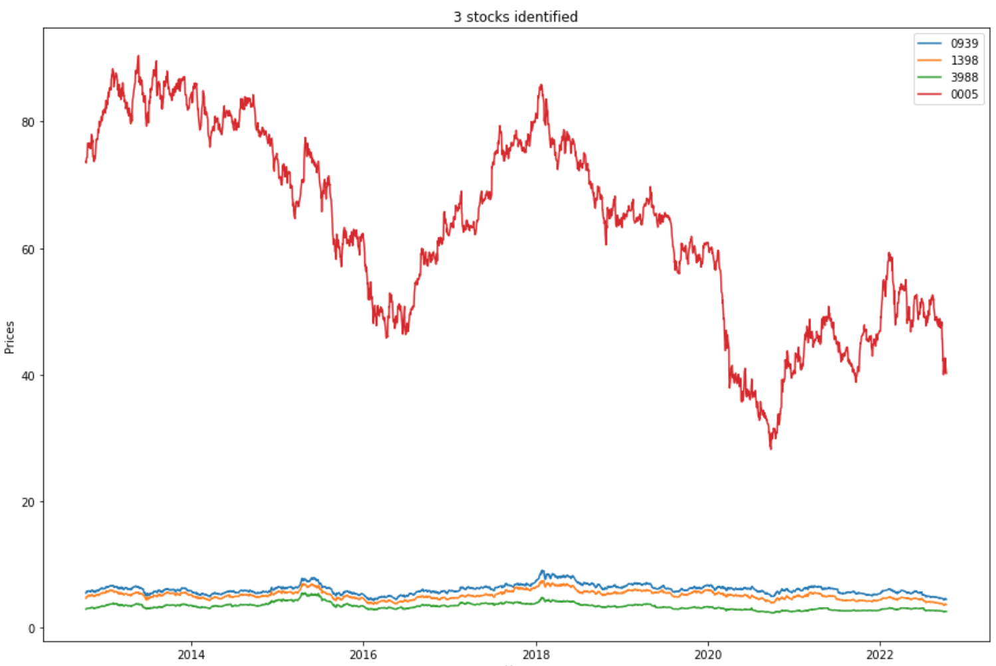
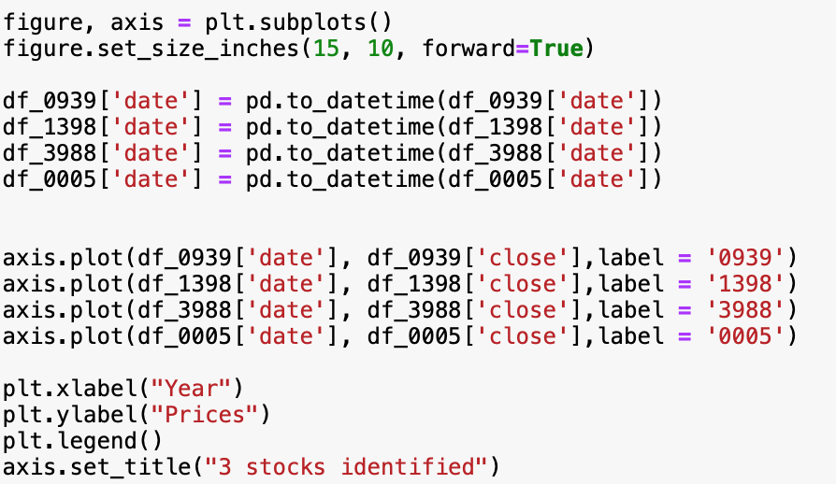
Line Graph - Comparision
Matplotlib
Movement of stock prices over the years
Plotting line chart of the 3 stocks with a well-known and popular stock
Red line depicts the price movements of HSBC (0005), trading at a much higher price

Slide 30
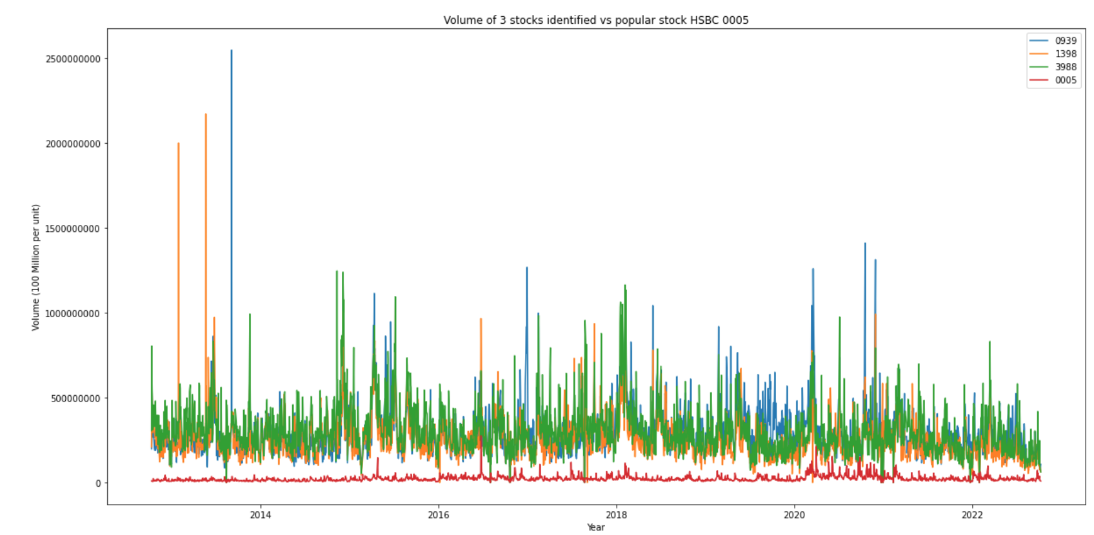
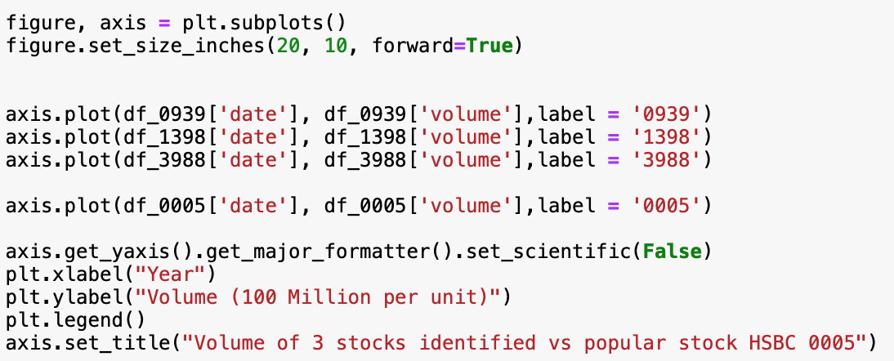
Line Graph – Trading Volume
Compare the trading volumes with HSBC 0005 again
Showing all these stocks are trading at a higher volume than HSBC
High liquidity (No issue with buying and selling)

Slide 31
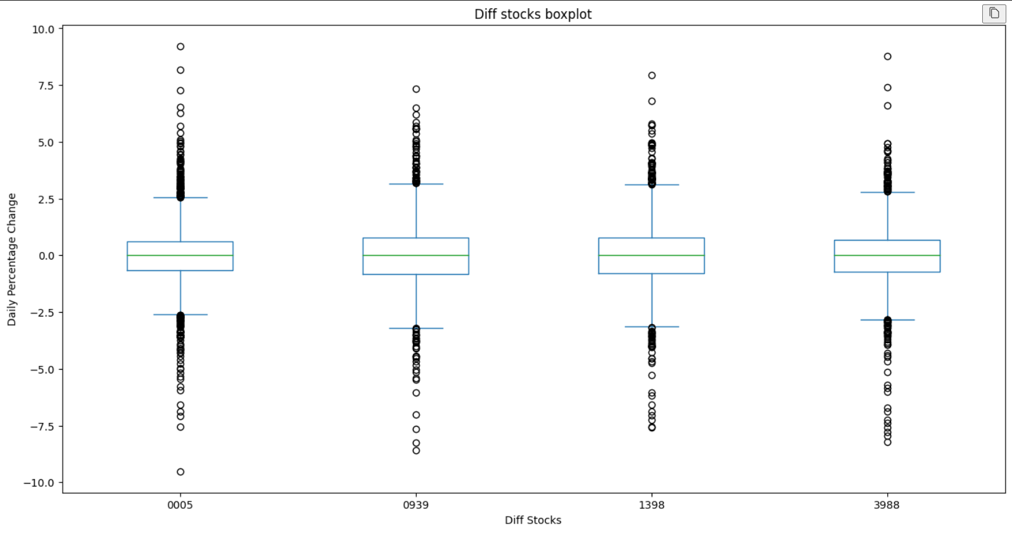
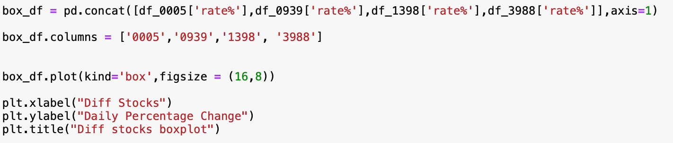
Box Plot – Volatility
pandas box method.
Comparing the daily return in percentage
The bigger the value either positive or negative the more volatile the stock is
All are similar but 0939 gives the greatest range
Suggest this stock is likely to be the most volatile

Slide 32
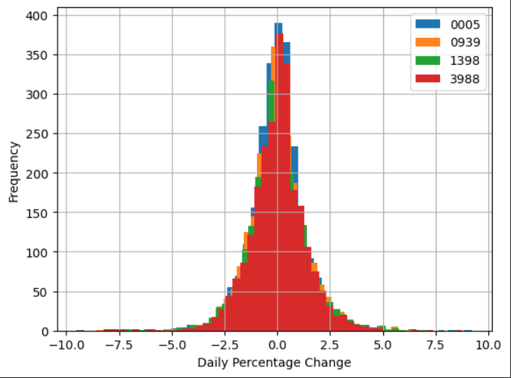
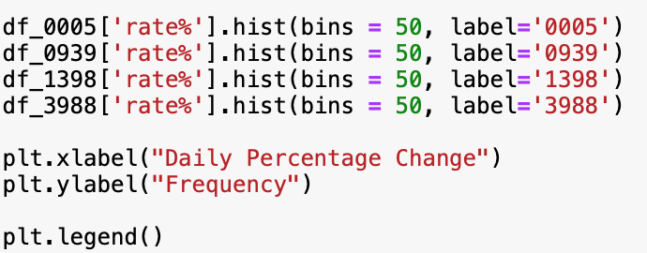
Histogram – Volatility
.hist method of data frame
Viewing the volatility of the 3 stocks from a different angle
The thicker the histogram, the more volatile the stock is
The width of the histogram shape is related to the standard deviation of the distribution

Slide 33
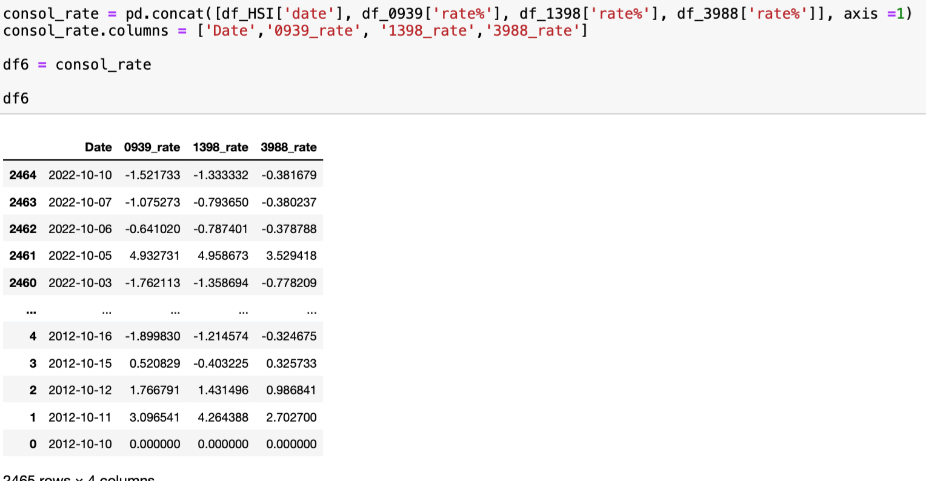
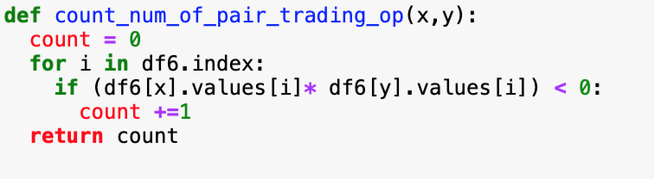
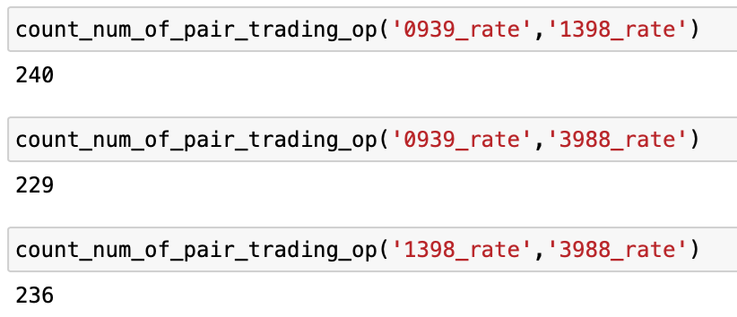
Function – Daily pair trading opportunity
Consolidated our data for ‘rate%’ for the 3 stocks with Date column
Ran a for loop and count days that 2 stocks temporarily deviates from trend
logic : if moving in the same direction:
+r% * +r% or –r%* –r% = always +ve
If not:
+r% * -r% or -r% * +r% = always -ve
Defined a function to do this for the 3 possible combinations
Output indicates that 0939 & 1398 combination has most trading opportunity over the 10 years
Performed further analysis on the volatility of the 3 stocks
Larger the area represent greater likelihood of being more volatile
Wider the graph links to greater spread
0939 has the greatest spread
Followed by 1398

Slide 34
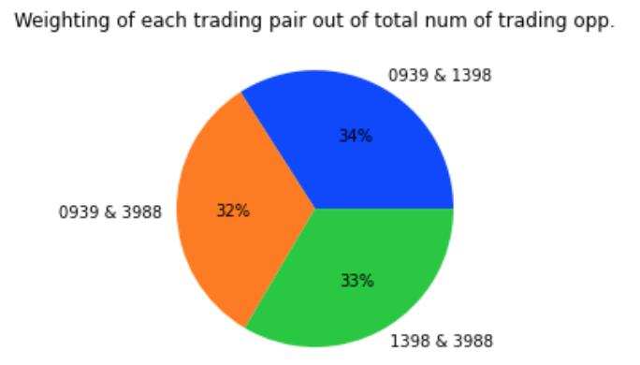
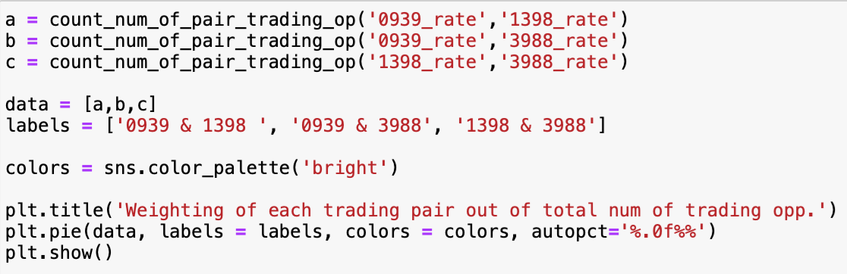
Pie Chart – Daily pair trading opportunity
Combination 0939 & 1398 has the most trading opportunity
Highest volatility , potentially more profits
Guaranteed high liquidity– easy to trade at any time

Slide 35
Limitations and challenges
Early stage of the project with BeautifulSoup and Selenium
Research on financial concepts to further enhance our vision on the project
Ways in which users would interpret historical data in order to structure our codes
Flow of the information returned to user

Slide 36
Taking it a step further…
Further compute the profit gaining probability from such strategy
Increase data points to increase reliability
Increase use automation
Taking into account of external factors
Returning data of customized date (earliest 1986.12.31)

Slide 37
Conclusion
Given the amount of time we were given:
Provide user with the best combination of stocks
Results base on historical data
Improvements on this program will allow further analysis
More reliable data for our users

Slide 38

Thank you for listening
The End

